Slide 1
Machine Learning for Electricity Demand Forecasting
in
California
Michael Boals

Slide 2
Value of Accurate Demand Forecasts
Demand Forecast
Labor
Management
Cash Flow Planning
Capital
Planning
Supply Chain
Budgeting
Notes:
Increase Supply Chain Efficiency
Improve Labor Management
Improve Capital Management
Insure Adequate Cash Flow
Improve Budgeting Accuracy

Slide 3
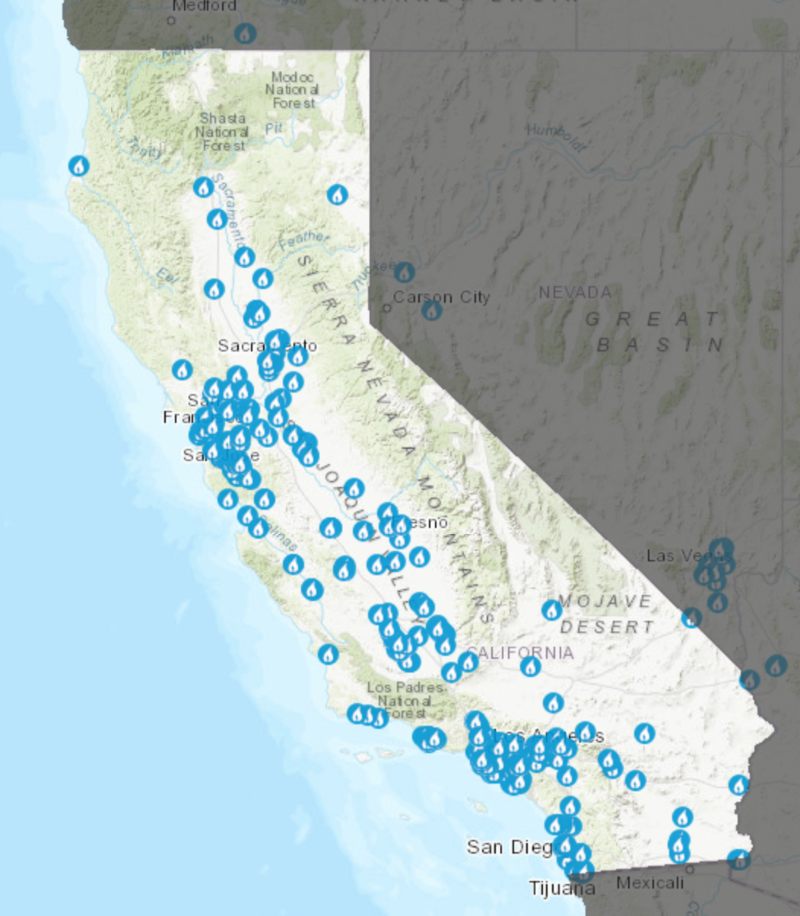
In California:
~ 200 Gas Fired Power Plants
Provide 33% of Electricity
Flexiblility → Supply = Demand
Planning:
Accurate Short-Term Demand Planning
Improves Operations Management
Improves Gas Supply Procurement
Accurate Long-Term Demand Planning
Drives Capital Improvements
Notes:
4 years of demand data at hourly intervals
Data has seasonal daily, weekly and yearly seasonal components

Slide 4
Goals
Evaluate Different Time Series Modeling Techniques
Accurately Predict Short and Long Electricity Demand
Include Weather Temperature Forecast
Include State Population Forecast

Slide 5
Model Options
Seasonal Autoregressive Integrating Moving Average (ARIMA/SARIMAX)
Prophet Forecasting Model
Notes:
Chose to evaluate SARIMAX and Prophet.
SARIMAX is a well known autoregressive model with moving average and differencing components. Adds a seasonal component but only one seasonal frequency.
Possible to incorporate additional seasons with Exogenous data
Prophet was developed in 2017 by two engineers at Facebook and also utilizes three components for its forecasting:
A trend component, a seasonal component and a holiday component.
The trend component is modeled with two parts: saturating growth model and piecewise linear model
The seasonal component uses Fourier Series at common business frequencies and the holiday component is modeled with linear regressors with activation windows around the holiday dates.

Slide 6
Methodology
Train and Test SARIMAX Models with Walk Forward Validation
Data Collection and Cleaning
Aggregate Data Over Three Sampling Periods
Evaluate Best Model Using Out of Sample Data and Simulated Weather Forecast
Train and Test FB Prophet Models with Walk Forward Validation
Notes:
Aggregated Data over day and week periods to try different inputs for models
Use Walk Forward validation for time series modeling
Simulated Weather Forecast for validation by introducing normally distributed error to the temperature observations

Slide 7
Model Selection
 | 3 Week Forecast Walk Forward Validation MAPE Scores
 | Step 1 | Step 2 | Step 3
SARIMAX
Hourly | 5.6 | 7.5 | 7.5
Daily | 13.14 | 11.7 | 7.0
Prophet
Hourly | 14.5 | 11.4 | 6.3
Daily | 8.7 | 2.9 | 5.16
Notes:
Make a graph – collect more data

Slide 8
Model Selection
 | 3 Week Forecast Walk Forward Validation MAPE Scores
 | Step 1 | Step 2 | Step 3
SARIMAX
Hourly | 5.6 | 7.5 | 7.5
Daily | 13.14 | 11.7 | 7.0
Weekly | 8.2 | 7.5 | 4.9
Prophet
Hourly | 14.5 | 11.4 | 6.3
Daily | 8.7 | 2.9 | 5.16
Weekly | 6.8 | 8.3 | 8.3

Slide 9
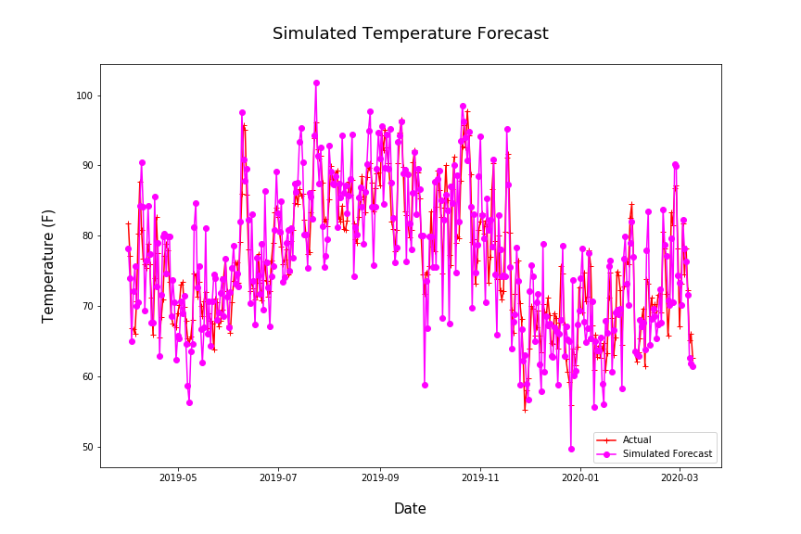
Exogenous Forecast Data
Need to simulate weather forecast
Add normal random offset mean of 5 F
Notes:
Longitudinal study on high temperature forecast accuracy

Slide 10
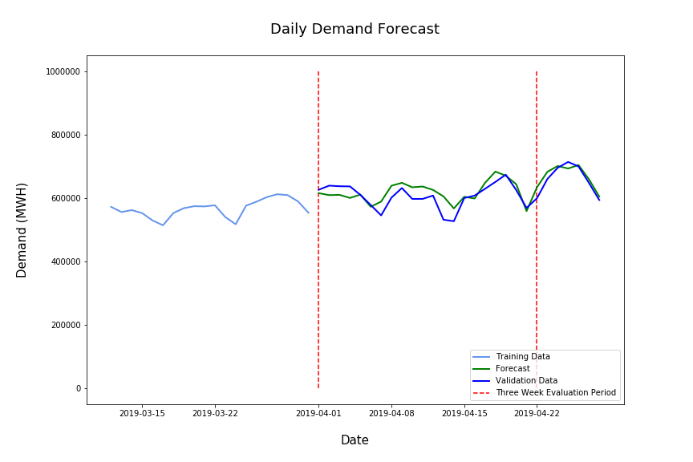
Final Prediction Performance

Slide 11
Take Away
Both SARIMAX and Prophet Provide Similar Short-Term Results
Prophet Performed Slightly Better
Prophet Trains Faster
Future Work
Explore Long-Term Forecasting Performance
Create A Tool To Make Forecast Accessible

Slide 12
Take Away
Both SARIMAX and Prophet Provide Similar Short-Term Results
Prophet Performed Slightly Better
Prophet Trains Faster
Future Work
Explore Long-Term Forecasting Performance
Create A Tool To Make Forecast Accessible
Thank You!

Slide 13
Appendix:

Slide 14
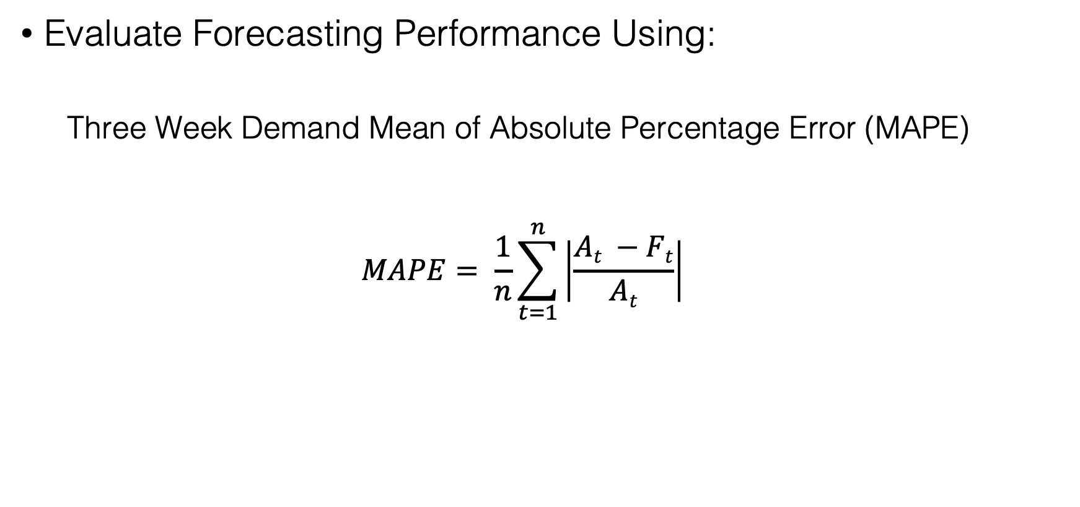
Performance Metrics
Evaluate Forecasting Performance Using:
Three Week Demand Mean of Absolute Percentage Error (MAPE)
$$MAPE= \frac{1}{n}\sum_{t=1}^{n}{\left|\frac{At −Ft}{At}\right|}$$
Notes:
Goal is to forecast two weeks ahead so I will use the three week mean as my metric for selecting a model.

Slide 15

Model Equations
Seasonal Autoregressive Integrating Moving Average (ARIMA/SARIMAX)
SARIMAX Equation
$$yt= βxt+φ1yt−1+…+φpy t−p −θzt−1− …−θqzt−q+zt$$
x_{t} = exogenous regressors
z_{t} = error/noise
Prophet Forecasting Model
$yt=gt+st+ht+ εt$
g_{t} = trend function
s_{t} = seasonal periodic changes
h_{t} = holiday schedules
𝝴_{t} = idiosyncratic changes not included in the model
Notes:
Sarimax Model
Prophet Model
Trend model is two models: saturating growth model and piecewise linear model
Seasonality is forecast using low pass filtered Fourier series
Holidays are modeled using linear regressors with activation windows around the holiday dates.

Slide 16
Seasonal Decomposition

